Slide 1



Goodcabs
View in Power BI
Last data refresh:
10/31/2025 2:31:12 PM UTC
Downloaded at:
10/31/2025 2:33:08 PM UTC

Slide 2
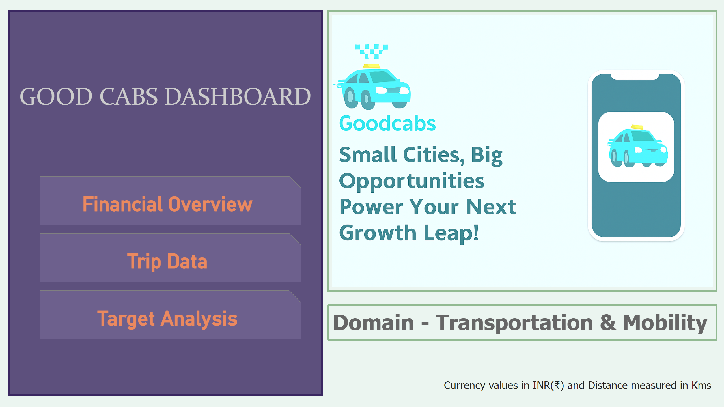
Info Page
Notes:
textbox
No alt text provided
shape
No alt text provided
image
No alt text provided
textbox
No alt text provided
pageNavigator
No alt text provided
textbox
No alt text provided

Slide 3
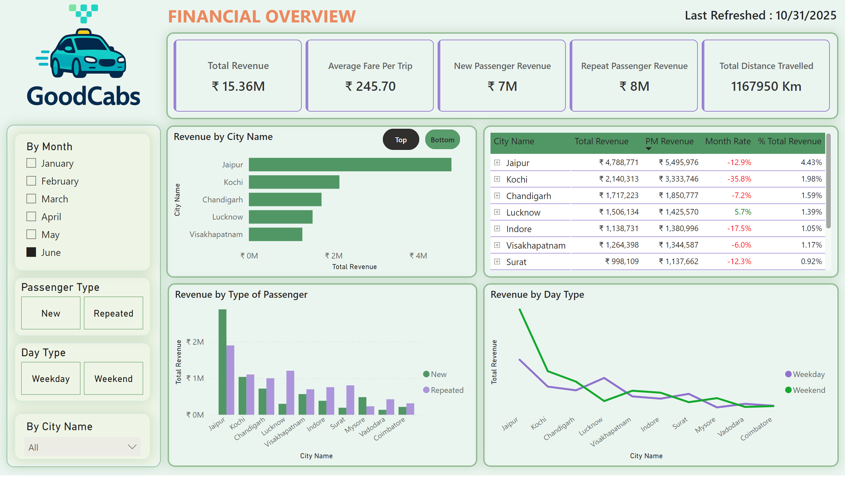
Financial Overview
Notes:
shape
No alt text provided
textbox
No alt text provided
image
No alt text provided
cardVisual
No alt text provided
slicer
No alt text provided
slicer
No alt text provided
advancedSlicerVisual
No alt text provided
advancedSlicerVisual
No alt text provided
Revenue by Passenger Type
No alt text provided
Revenue by City Name
No alt text provided
pivotTable
No alt text provided
Revenue by Type of Passenger
No alt text provided
Revenue by Day Type
No alt text provided
card
No alt text provided

Slide 4
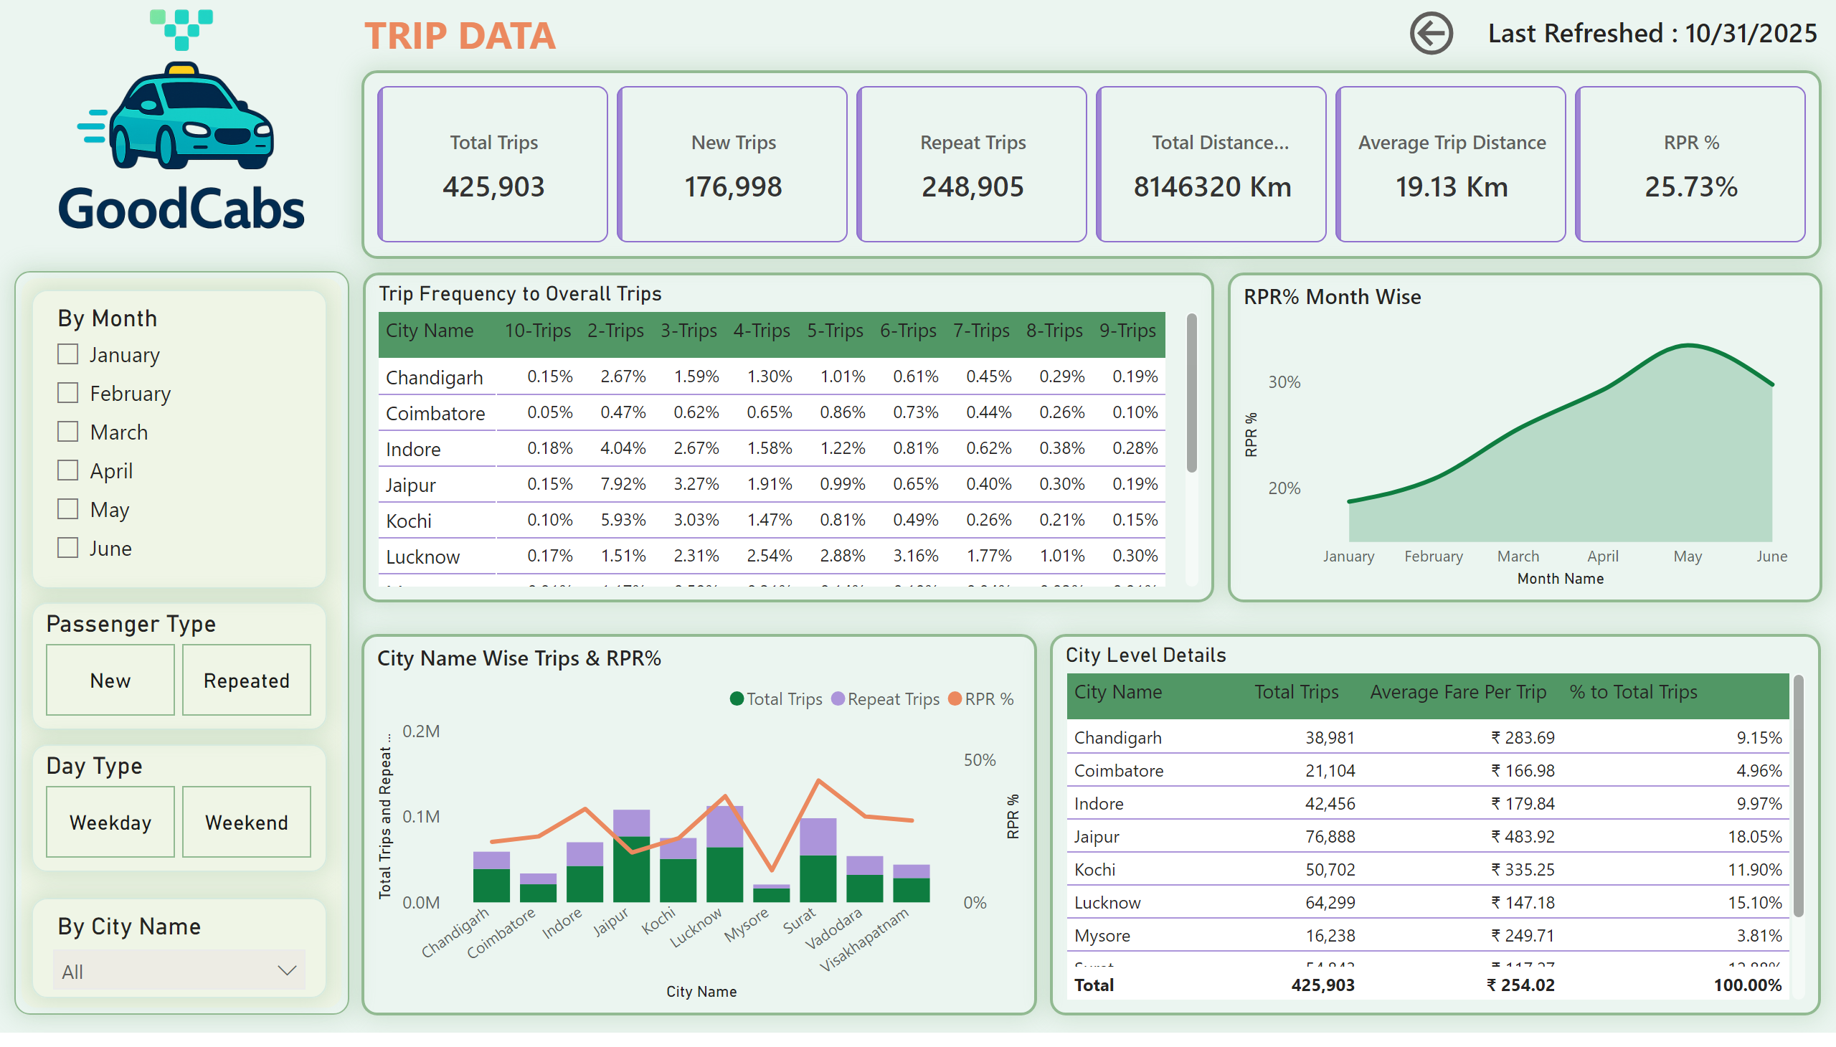
Trip Data
Notes:
shape
No alt text provided
textbox
No alt text provided
image
No alt text provided
cardVisual
No alt text provided
slicer
No alt text provided
slicer
No alt text provided
advancedSlicerVisual
No alt text provided
advancedSlicerVisual
No alt text provided
City Name Wise Trips & RPR%
No alt text provided
Trip Frequency to Overall Trips
No alt text provided
City Level Details
No alt text provided
card
No alt text provided
RPR% Month Wise
No alt text provided
actionButton
No alt text provided

Slide 5
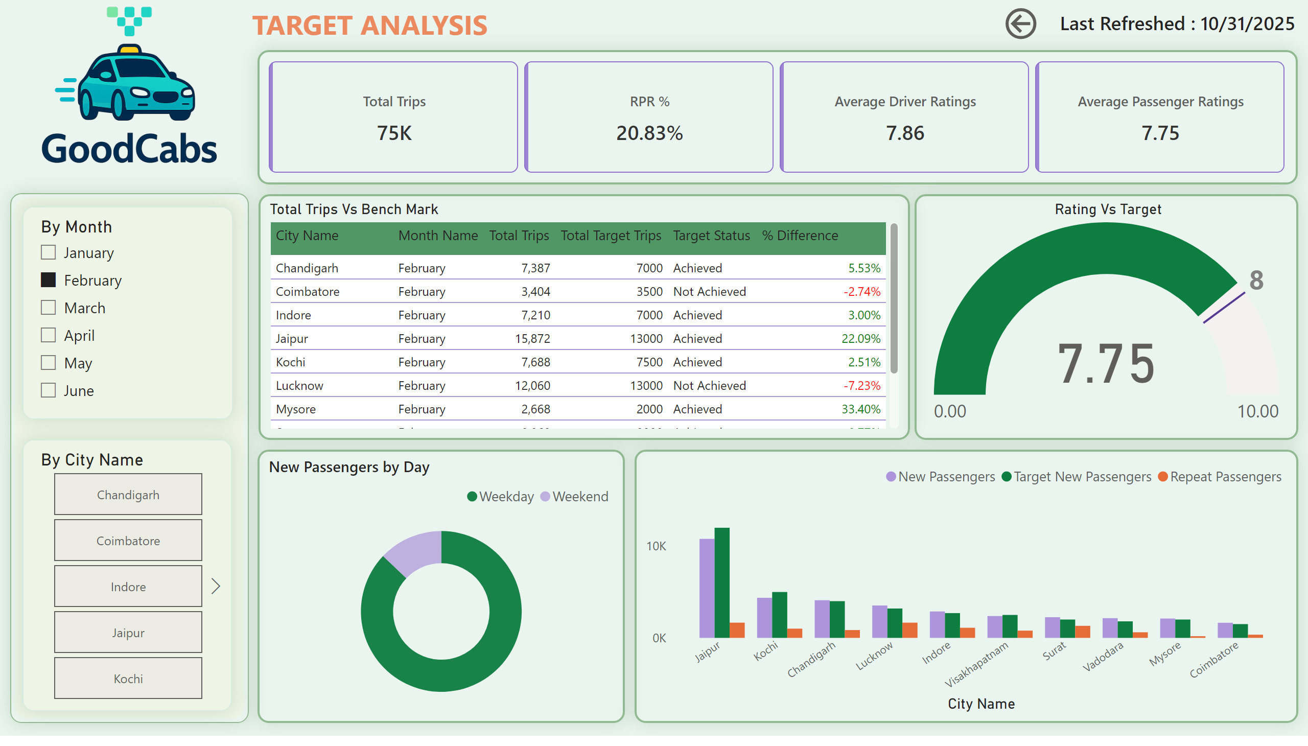
Target Analysis
Notes:
shape
No alt text provided
textbox
No alt text provided
image
No alt text provided
cardVisual
No alt text provided
slicer
No alt text provided
slicer
No alt text provided
New Passengers by Day
No alt text provided
Total Trips Vs Bench Mark
No alt text provided
Rating Vs Target
No alt text provided
card
No alt text provided
clusteredColumnChart
No alt text provided
actionButton
No alt text provided

